Slide 1

ever wanted to roam at your favorite place, without crowding ?
if yes was your answer, here is
kontrol
a thought out of the box platform to reduce and mitigate crowd, and enhance your experience through the city!
so let’s hop into it
ARJUN PANDEY

Slide 2
Micro-scaling for kontrol
To give you an insight of our model we have considered one of the busiest and most crowded marketplaces in India i.e Chandni Chowk.
The model has been developed keeping in mind the various levels of crowding scenarios in different parts of Delhi. For example:
Ali Vihar- Green zone (Scarcely crowded)
Delhi IGI Airport- Yellow zone (Moderately crowded)
Chandni Chowk- Red zone (Highly crowded)
Our main focus will be to mitigate crowd in places with crowd rating of 7 or above for more than 3 days a week (red zones) to avoid any kind of stampede and maintain safety of the shoppers/visitors.
Detailed colour coded map of Chandni Chowk is featured in next slide. It features a legend tab for a convenient reading and better understanding.
We will also be going around the designated zone and adding different shops/attractions to our database so the user finds it easier to navigate through the confusing lanes.

Slide 3
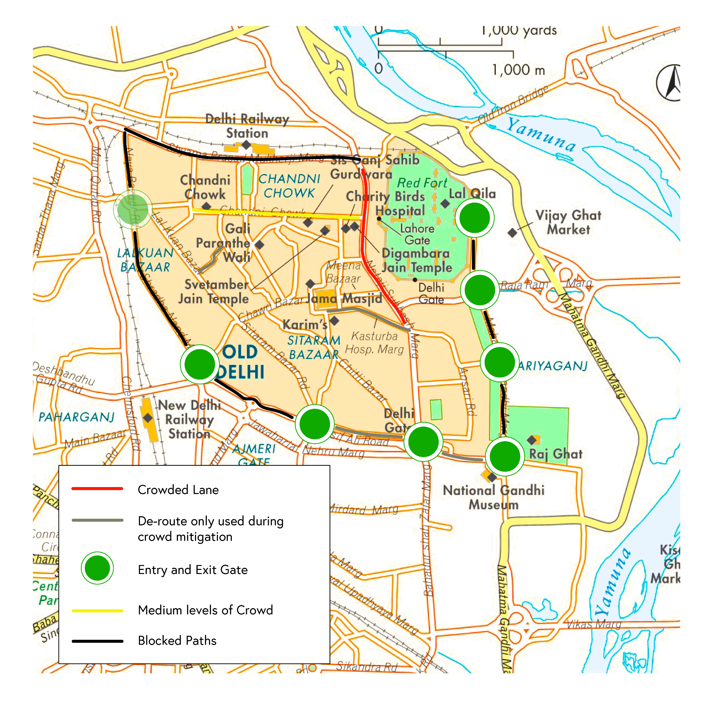
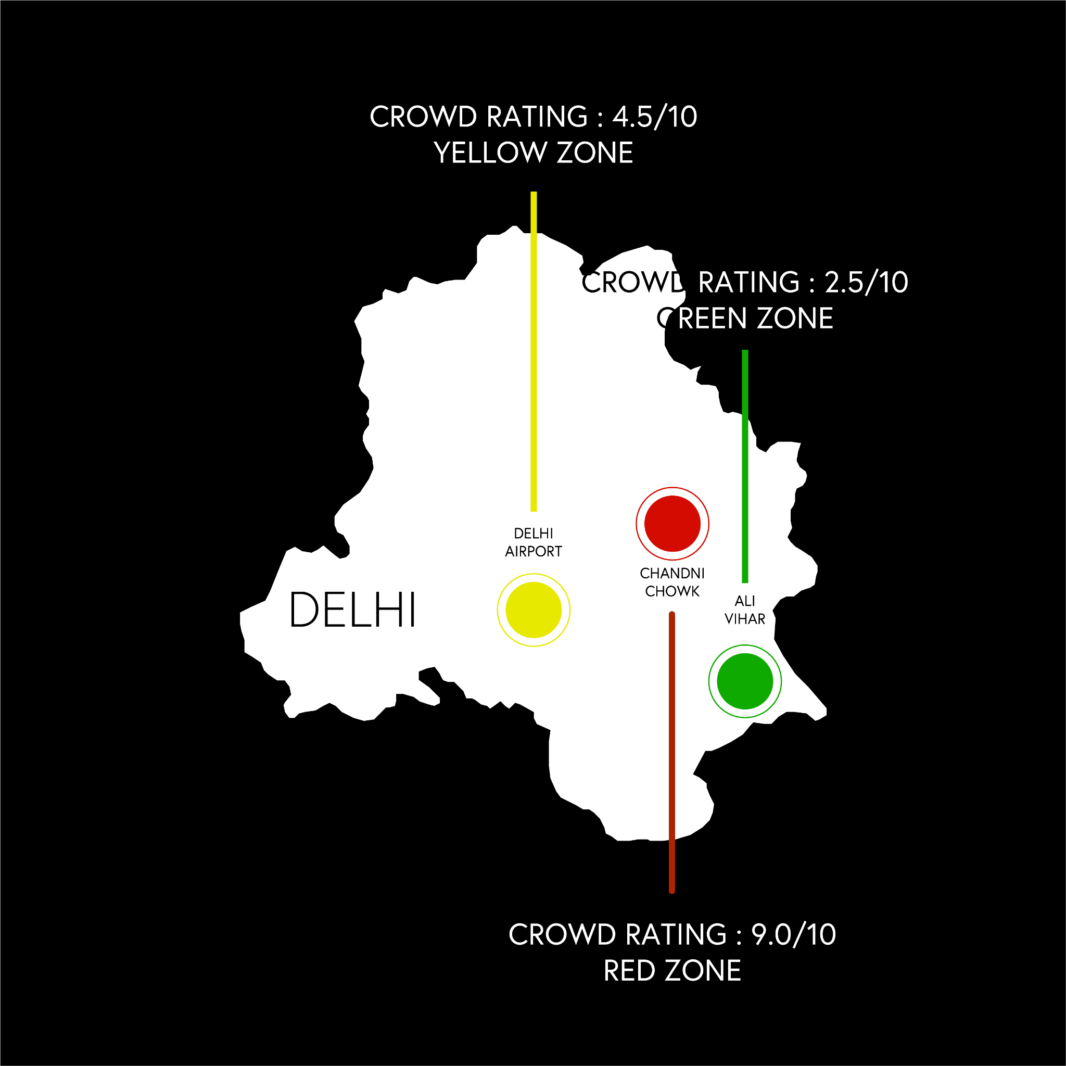
MI
Crowd ratings given to three specific zones of Delhi, and micro-scaling to one specific red-zone. The red zone is specified by its lane and by-lanes and entry-exit gates.

Slide 4
Infrastructure
The first and primary infrastructure will be an aluminium always-open inverted U type of gate, which will have an attached Thermal Sensor and Sanitiser, Metal Detector, headcount, and IR Sensor. These gates will have 3 lane entry and 3 lane exits attached side-to-side. Gates will be managed by a minute office with the reports and data of sensors, manned by 2-3 people. These entry and exit gates shall be isolated within a radius of 50-60 meters from the pedestrians, this shall be monitored by civil police.
Metal Detector - for detecting the possibility of a weapon or any susceptible danger causing material, and checking for related materials. Moreover, it will lessen the need for manned frisking, and easy entering, making the process swifter and smoother, creating less chaos at entry points.
Thermal sensor - will be used for checking temperatures, which was earlier manned. This will further negate the risk of COVID-like disease spreading in crowds.

Slide 5
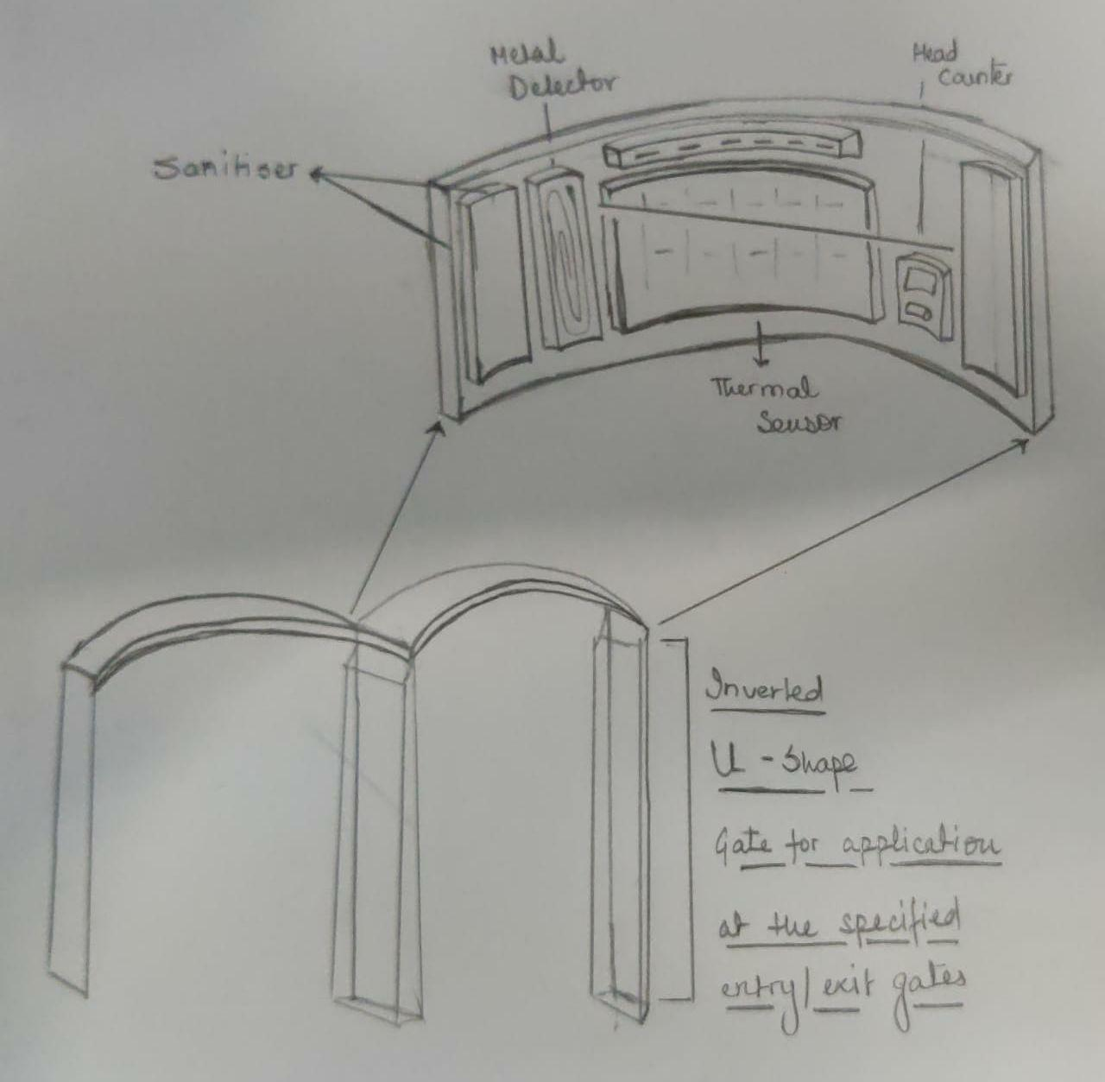
Head Counter - it will add one person if entering from the entry gate, and subtract one person if using the exit gate. It will negate the risk of people being lost in markets and crowded places, and further also tell people to maintain the recommended amount of people in a lane.
concept art of the gate

Slide 6
Business/Revenue model
Shuttle Service will be a transport carrying a lot of 20 people at a time from the entry gate to a centrally connected place (in case of Chandni Chowk, it is Jama Masjid). The frequency of these shuttle services will be every 20 minutes. These will prevent the use of transport in these specific zones, and make the people reach faster. Driven by our workforce, it will be the fastest way to commute inside the zone. 0% of each lane and by-lane will be monitored to be used by pedestrians, and the remaining will have the shuttle services running.
This service will be chargeable with prices varying between Rs 5 to 20 depending on the distance. We will also be using the shuttles for advertising through posters on them and therefore generating revenue.
For keeping the entry points vacant and to prevent chaos at these points, vehicles will be diverted towards the parking spot. People visiting the market through personal vehicles can avail parking facility at minimum cost and hence is another source of revenue generation.

Slide 7
Digital Notification Boards with speakers will be placed at every lane, with notifications like AQI, recommended people in the lane, and routes of the nearest exit. The pixels in the boards will change colours from green to yellow to red, with green being safest and maintaining the required crowd, red being most crowded, and crossing the recommended mark by a margin. In these red zones, our nearest workforce employees will first mitigate the crowd using the nearest de-route (to the nearest exit or nearby safer lane), making way for people and creating a less crowded environment.
We are aiming to generate revenue by advertising ads on digital boards. These digital boards will feature ads from public sector as well as will be displaying Government safety schemes like LIC, Jago Grahak Jago etc.
Since the start-up is government partnered, our App will mostly feature ads catered by the government.
The expected initial funding for the successful launch of each zone will be around 3.5 - 4.0 Cr. Consisting of:-
Infrastructure (one time investment) for 1.92 Cr.
Which is further divided into:-
Recycled aluminium gates for 70 lakh
Machinery for 1.22 Cr.

Slide 8
Annual salary for our workforce consisting of 60 members and an approx cut of 85 lakhs out off the total requirement.
The notification board on every by-lane intersection will cost about 60 lakhs which will be made up of recycled metals.
Lastly the miscellaneous expenditure and localized labour will amount to 30 lakhs.
The user fee is free for the first year to increase the popularity among the denizen.
The revenue generated by the digital notification board, controlled shuttle services and the app advertisements amounting to 2.52 Cr per zone helping us being self sufficient after a few years.
(Graph for the estimated data has been shown in the next slide.)

Slide 9
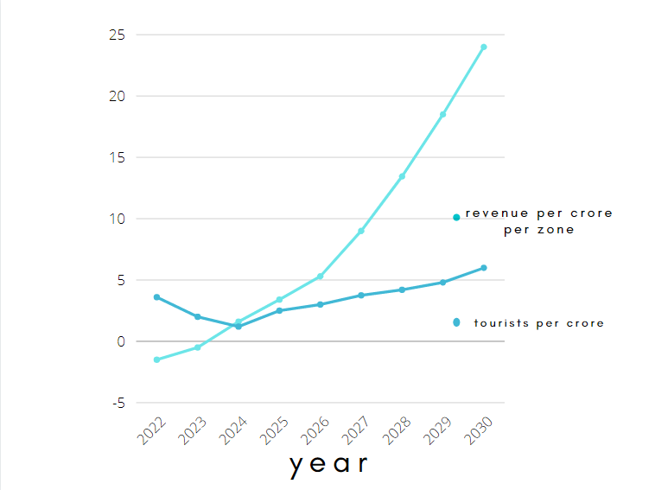

Slide 10
Feasibility and eco-friendly nature of kontrol
Implementing this model at various zones throughout the country will eventually create a lot of job opportunities. People will be employed as workforce for monitoring entrance/exit points as well as for crowd mitigation. There will also be workforce kept on standby in case of stampede and will be responsible for guiding visitors to safety.
Existing E-Rickshaw drivers will be approached for transport. It will also be beneficial for them as they are scattered and this will boost their earning potential.
Our model will be using recycled metals for entry/exit arch, shuttle service being electric can be charged using solar energy and eventually help reduce overall pollution.
Eventually the startup will require funding from the government but the revenue model we have designed will be highly effective and will be able to retrieve the invested money back and eventually will lead us achieve sustainability and become a successful self dependent model.

Slide 11
App info
The application will be an integrated module with Google Maps and Aarogya Setu.
The application will guide the civilian user to his/her required shop or venue, using the nearest and safest route through this zone.
The shop owners/business owners can only use the app for displaying their business and shop, further, they can log the details of civilians inside the shop, to restrict to a healthy and safe number of people.
The workforce employees will be notified of the nearest red zone and the nearest de-route to safer zones or exit gates (most crowded lanes and bylanes), helping them mitigate the crowd faster.
The Google Maps integration can tell you easily, while you are sitting at home, if the intended place of your visit is crowded or not. This will help you plan your schedules accordingly.
The app will be categorized into 3 windows: -
The first will be for the shop owners and business owners. They will have to enter their Shop Numbers, Name, Telephone to log in, and Location.
The second will be for our workforce (shuttle and our force). They will have to enter their employee id and Aadhaar Details.
The third will be for the Civilians. They won’t require anything particular to log in; they have to integrate with ‘Aarogya setup to start the app.
In the case of international tourists, they will be asked for a copy of their vaccination report dating back to a maximum of 45 days at the entry point.

Slide 12
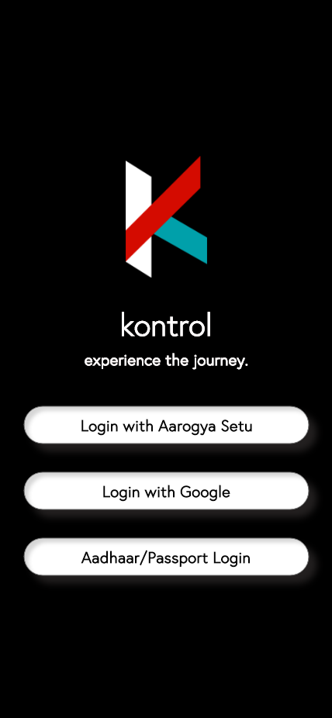
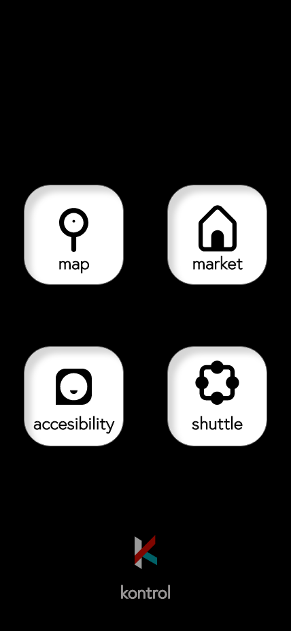
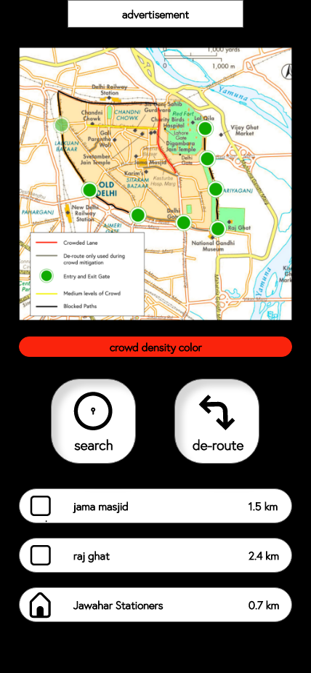
User Interface

Slide 13
Mitigating the crowd
In case of overcrowding or stampede, a special protocol will be initiated and the workforce will be specially trained to effectively manage and mitigate the crowd. Under the special protocol entry points will be transformed into exit and workforces will coordinate and start delocalizing the crowd in a systematic manner to avoid scrimmage.
By converting the entry gates to exit, we can double the potential of crowd
mitigation.
In case of stampede,the gray lanes or areas(shown in the map in third slide) will become functional for easier dispersion of the crowd and these lanes can always be used by our workforce for easier accessibility.

Slide 14
THANK YOU

